Slide 1
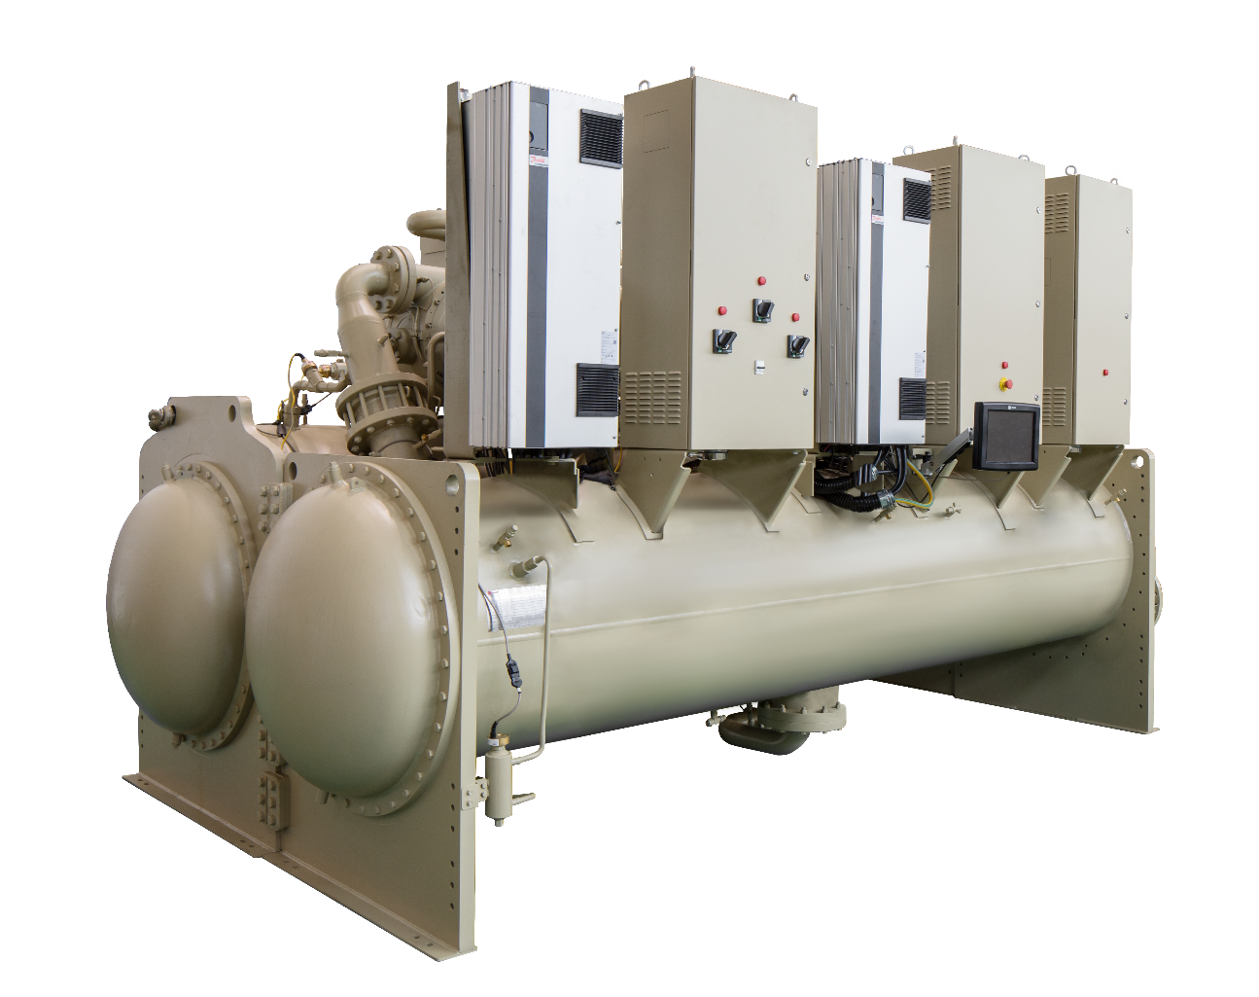
HSWB SERIES

Slide 2
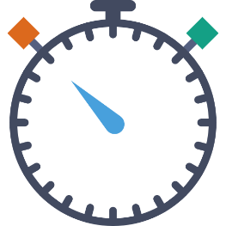
Key Decision Criteria
What is important to you?
Life Cycle Costs
Efficiency
Reliability
Footprint
Installed Cost
Lead Time
Understanding Requirement is Key to Selecting the Right Chiller

Slide 3
HSWB Maglev Centrifugal Chiller
Reliability multi-compressor design for better stability
Efficient delivers better efficiency curve from hybrid compressor control
Environmental benefits to meet sustainability goals
Full load eff @ AHRI | 0.52kW/RT COP 6.8(R1234ze)
IPLV @ AHRI | 0.303kW/RT IPLV 11.60 (R1234ze)
Balancing Size, Cost, Performance, & Reliability

Slide 4
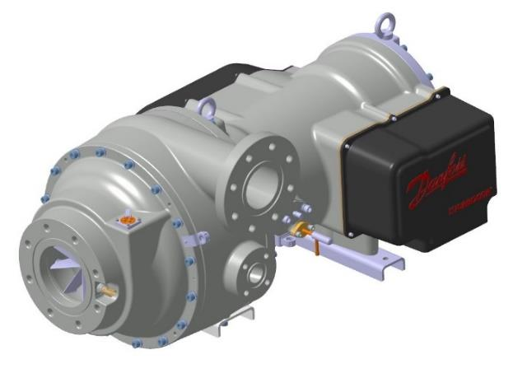
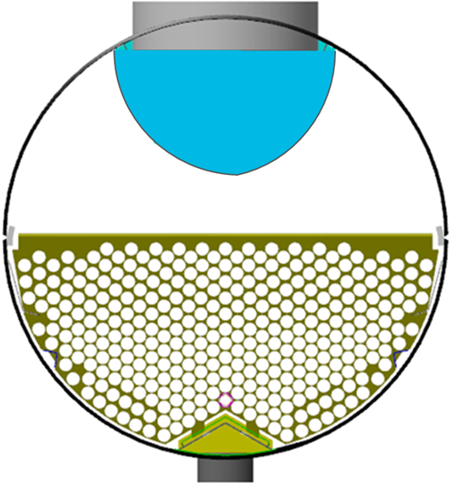
Design Features
Compressor Design
Hybrid control
Efficient Evaporator
Semi-Hermetic compressor
Direct drive - Fewer Moving Parts 2-Stage/HSDD Design
Hybrid compressors
Optimized sequence
Best efficiency for all load%
Reduces refrigerant charge by up to 25% and evaporator footprint
Increased reliability for reduced carryover risk
Trane Designed, Trane Manufactured, Trane Backed

Slide 5
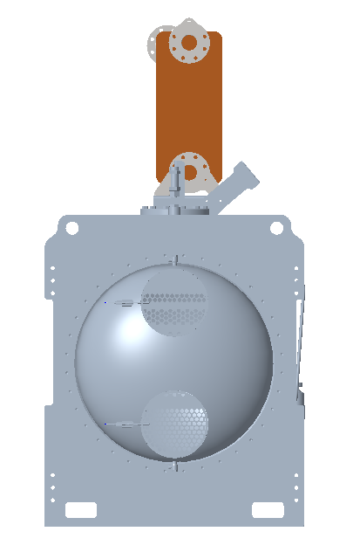
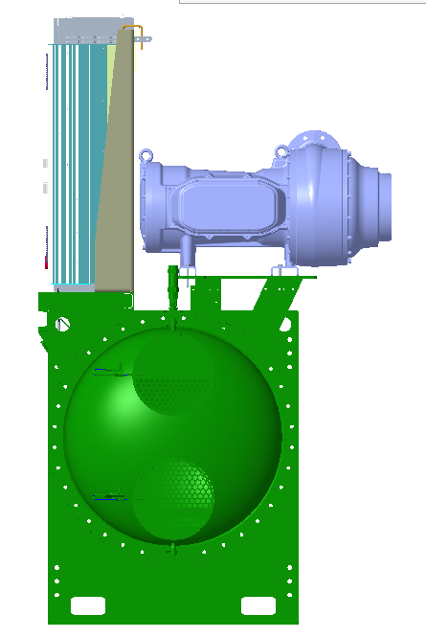
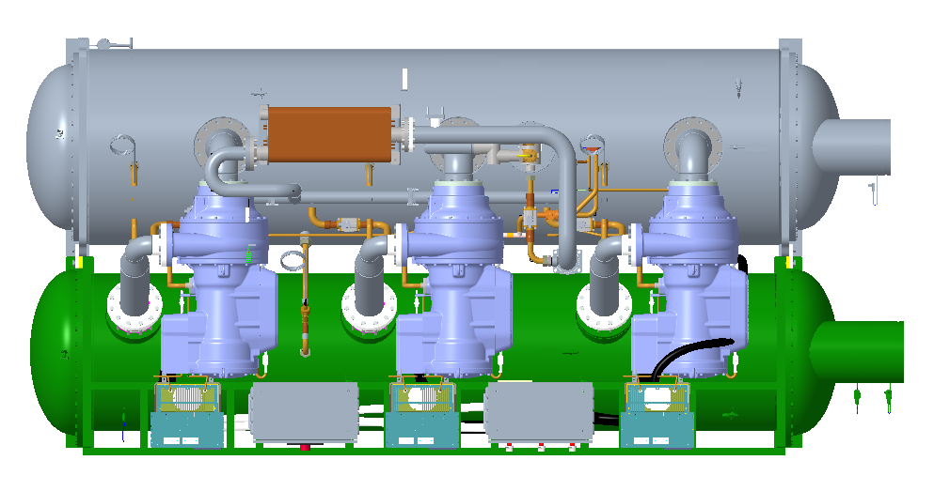
Disassembly for shipment and installation

Slide 6
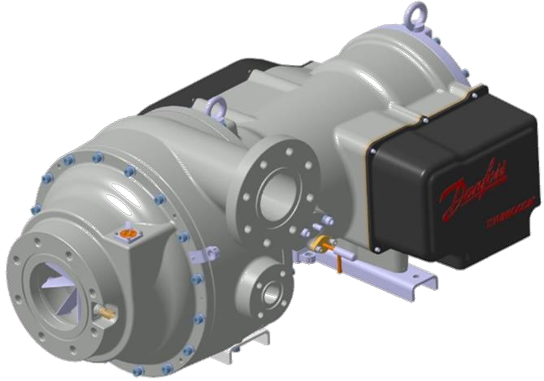
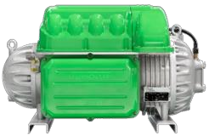
VTX Compressor
Robust and Efficient Compressor Design
Multi-stage, Direct drive
Magnetic Bearings
Speed optimized for refrigerant
High Efficiency Unloading – The VTX compressors uses an updated Aero-Design with IGV for extended unloading range that does not sacrifice efficiency at low load conditions
Improved Ingress Protection – IP Rating of IP54 on Compressor
Hybrid compressors for optimization
Efficient with overall load range
VTX+TT(TGS)
Cover densely distributed NTON
Optimized full load efficiency
Optimized part load efficiency

Slide 7
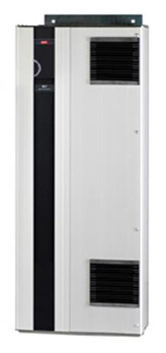
Dedicated Drive for VTX compressor
Air-cooled Drive
Condenser & Sub-Cooler
◼ Proven Reliability - air-cooled drive to offer supplemental refrigerant cooling to meet
peak demand but also provide redundancy at nearly all operating conditions.
◼ Highest Efficiency - High power frequency drives are the most efficient drives in the industry.
◼ Intelligent Control - Improved Diagnostics and Monitoring integrated into Compressor Control
◼ Standardized Platform - Voltage applications between 380V to 460V are covered
Other benefits:
◼ Built-In DC Coils eliminate the need for Line Reactors
◼ Built-In Fuses
Fast, Responsive, and Optimized

Slide 8
Economizer & Sub-Cooler
Condenser & Sub-Cooler
Condenser & Sub-Cooler
Economizer
Refrigerant to refrigerant Brazed Plate Design
Small portion of condensed liquid is flashed to inter-stage pressure
Primary liquid flow is delivered to heat exchanger
Economizer
Back to inter-stage
of the compressor
Integrated Sub-Cooler
Condenser & Sub-Cooler
Condenser
Lowers the enthalpy and pressure prior to economizer
Improved chiller performance
Higher chiller capacity
Smaller heat exchangers
Intermediate sub-cooling baffles induce mixing and guide/support tubes
Sub-Cooler
EXV
Primary EXV
Evaporator
Industry Leading Heat Exchanger Design Delivers Efficiency

Slide 9
Falling film Evaporator
Falling film Evaporator
Reduces total refrigerant charge
Reduces evaporator footprint
Improves efficiency over flooded designs
Reduces risk for carryover for increased reliability
2-Pass reversible water boxes
Means Less Charge, AND Efficiency

Slide 10
Rapid Restart – Best class in industry
Oiled chiller @ short power failure
IGV Reset
Check oil temperature
Confirm oil flow
Compressors run
0
300
Time (Secs)
Power restored
Compressor restarted
HSWB Rapid Restart @ long power failure
Chiller pre-start check
Compressors run
0
70
Time (Secs)
Power restored
Compressor restarted
HSWB Rapid Restart @ short power failure
Chiller pre-start check
Compressors run
0
25
Time (Secs)
Power restored
Compressor restarted

Slide 11
Rapid Fast Restart Advantages
No oil related pressure and temperature checks, safeties or timers. No mechanical stress on compressors during restart
No hours based limitation on number of restarts (open drive compressors should only be restarted twice an hour)
No loss of communications with Chiller controller.
Fast chilled water recovery with dedicated programme - eliminate the need for additional thermal storage

